Slide 1
WEB APPLICATON ON : ONLINE VOTING SYSTEM
yuvarajasimha Reddy (AP21110011248)
JASHWANTH –(AP21110011

Slide 2
Agenda
1 . ABSTRACT AND APPROACH
2 . Introduction
3 . The Current Voting System
4 . Advantages of Online Voting
5 . Implementing of Online Voting System
->Flow of execution Process
->Algorithm
6 . Sample Output

Slide 3
ABSTRACT
Online voting, also known as e-voting, is a modern approach to the traditional voting process that allows individuals to cast their votes electronically via the internet. This digital voting method has garnered significant attention in recent times due to its potential to enhance democratic participation and address the challenges of traditional voting systems. As a Computer Science and Engineering (CSE) student, understanding the complexities and innovations of online voting becomes essential in exploring its feasibility, security, and potential impact on the electoral process. This abstract delves into the technical aspects, advantages, and challenges of online voting, presenting an overview of its role in shaping the future of democratic elections

Slide 4
THIS IS OUR APPROACH TO THE PROJECT IMPLEMENTATION
In This Project we are conducting Elections for two States they are Andhra Pradesh and Telangana we follow same Process which is Given Below
The Project Start with Starting page in this it contains registration button then it navigate to Another page called registration page and user want to fill is form while filling this form it ask Select Your State if you select state as Andhra Pradesh you registered for only Andhra Pradesh same as well as Telangana also. And After filling this form it redirect to Home page and mean while it send mail to user for confirmation. After getting Home page it has two sections they are called voter section and Result Section
Voter section – For voting user(vote-AP, Vote-Ts)
Result section – It Display the result

Slide 5
Introduction
Now a days Internet Making Big changes in World technology . In The Future one of the Application is:
Online voting systems are rapidly gaining popularity as the world is adapting to modern technology. This presentation will explore the advantages, and implementation of an online voting system.

Slide 6
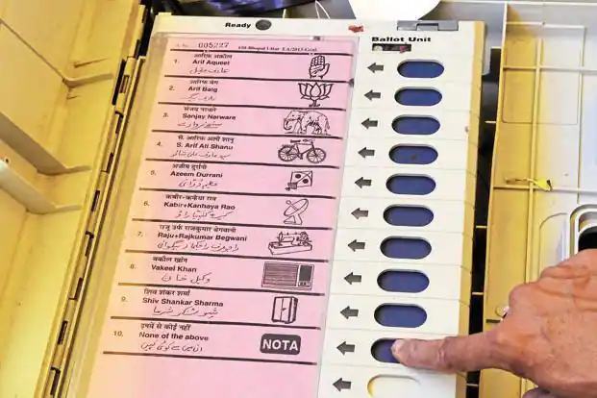
The Current Voting System

Slide 7
The Current Voting System
THE Current voting System in India is Electoral System
Disadvantages:
The voters are in Queue for long time to give the valuable
Vote
For Electoral System it takes Power

Slide 8

ONLINE VOTING SYSTEM

Slide 9
Advantages of Online Voting
Convenience:
24/7 availability of online voting from anywhere with an internet connection.
Cost-Effective:
The implementation of an online voting system can be much cheaper than traditional voting methods.

Slide 10
Implementing of Online Voting System
-> We are Implementing online voting system By using
Software Deployment of Web technologies By using
Python software and its Django Frameworks
->Examples of countries Implementing Online Voting
*Estonia- IN 2005
*Switzerland – IN since 2003

Slide 11
Flow of execution Process
Starting page
Registration page
Home page
Voting section
Result

Slide 12
Algorithm
Step-1 : START
Step-2 : It goes to registration page it contains details it must be filled by the user then only it goes to Step-3
Step-3 : if (step-2==True):
return to Home page
else:
return to Step-2

Slide 13
Algorithm
Step-4 : v=1 -> If user select to voting
r=1 -> if user select to Result
if (v==True):
return voting process
elif(r==True):
return Result
Step-5 : END

Slide 14
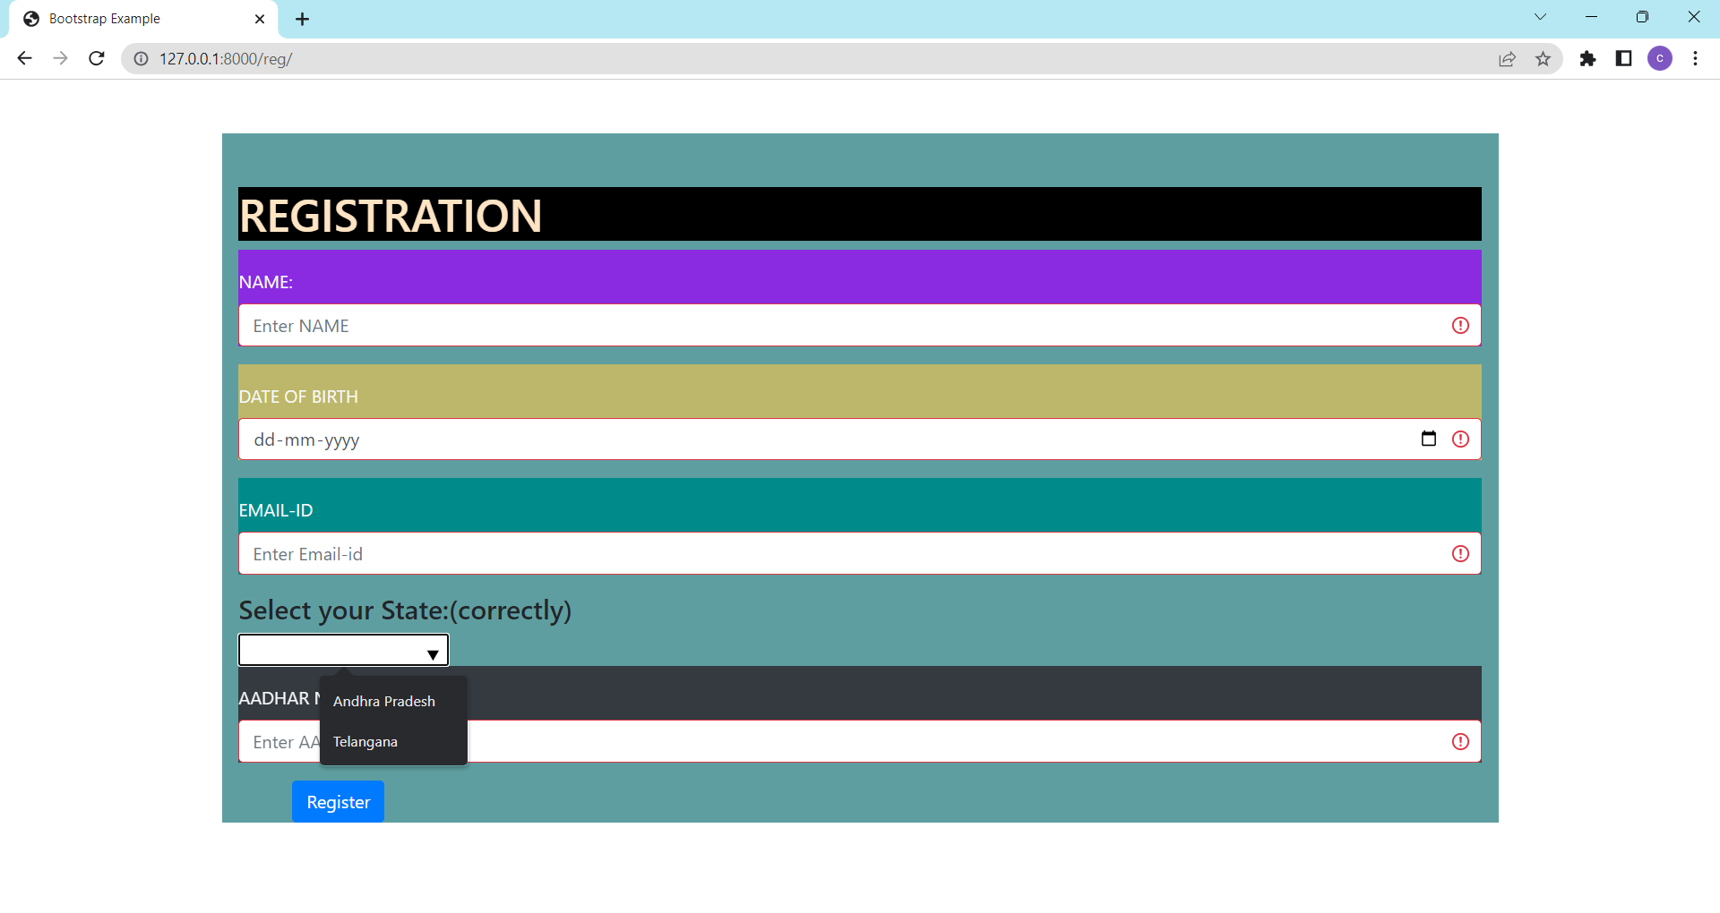
Sample Output-1

Slide 15
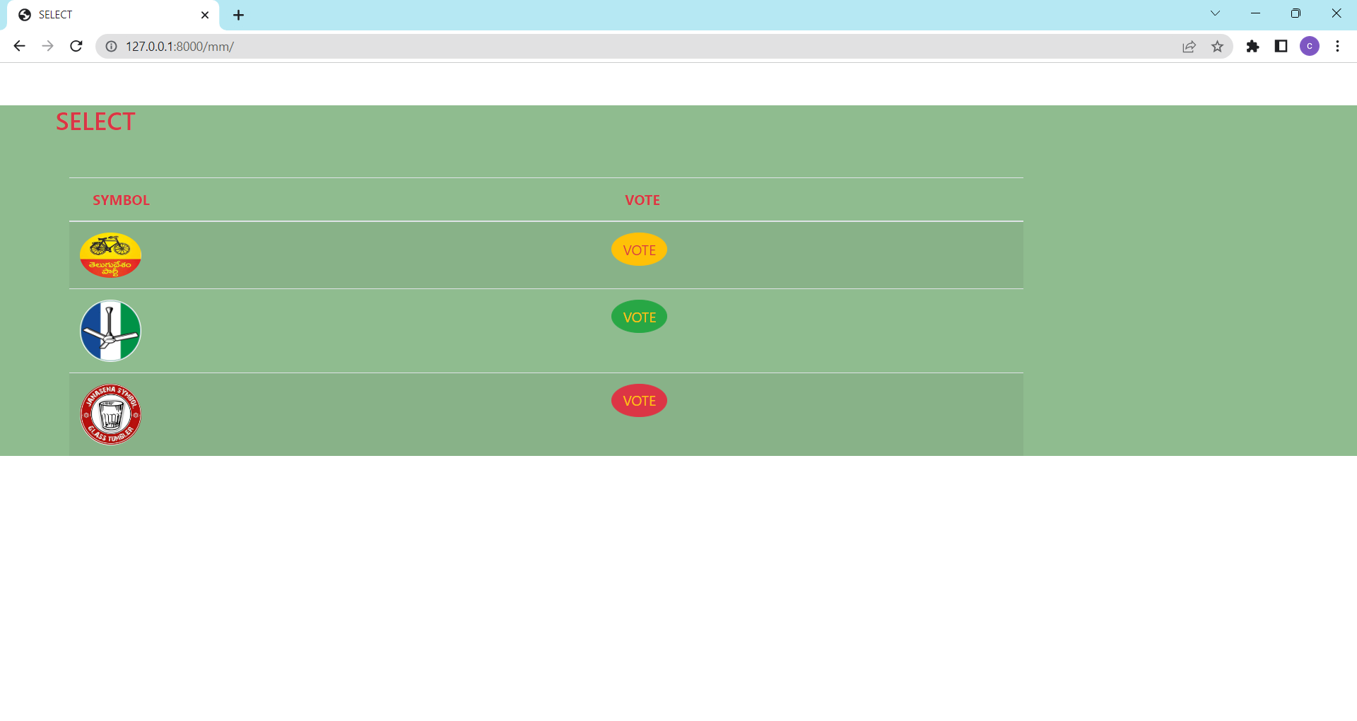
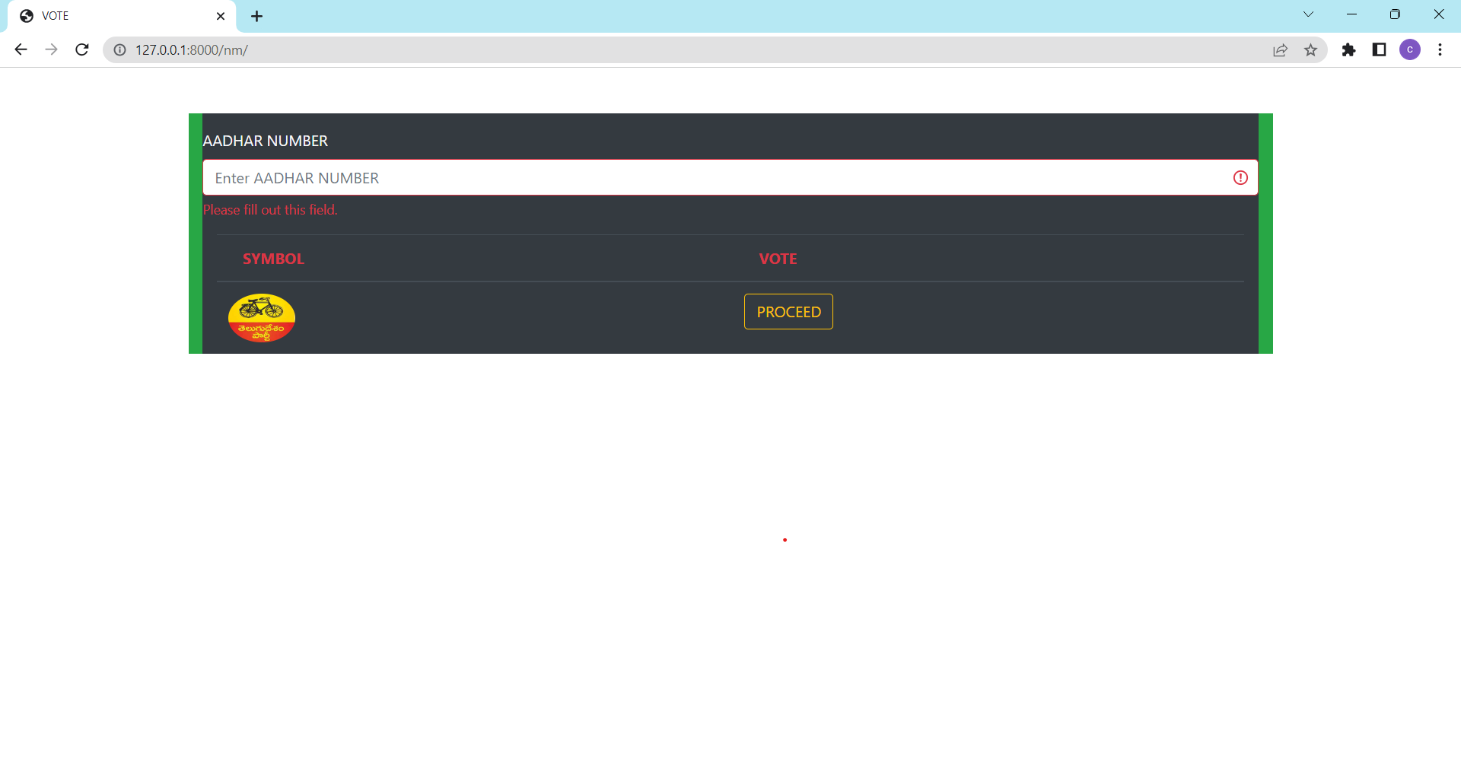
Sample Output
Sample output-2
Sample output-3

Slide 16
Thank you

